Slide 1
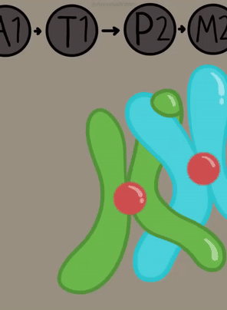
Meiosis and Genetic Diversity
AEHBY Human Biology

Slide 2
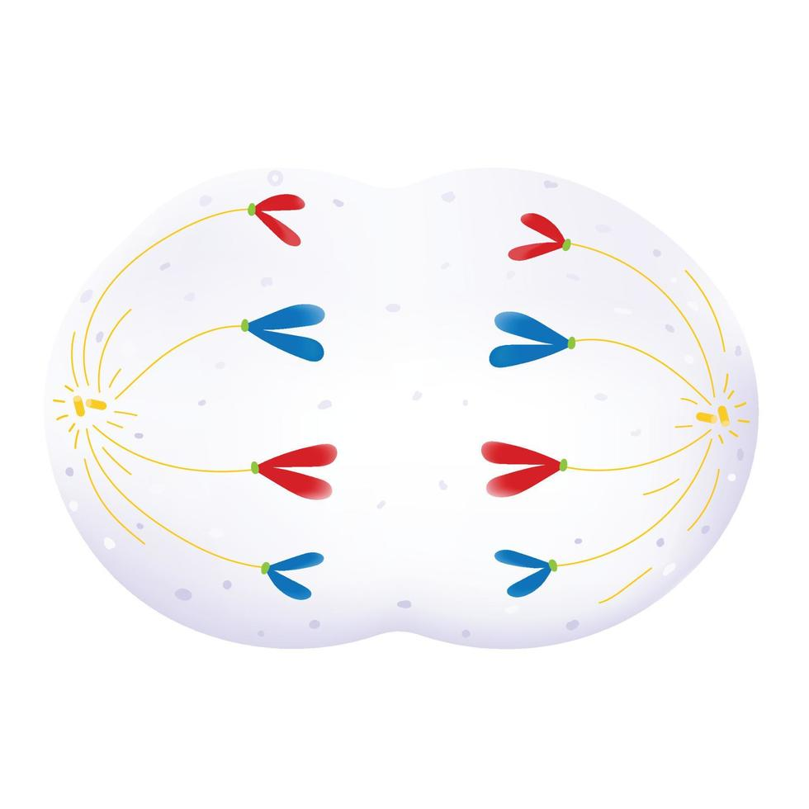
Review
The above image shows a cell during a phase of mitosis.
a) Name the organelle shown outside the nucleus, in the cytosol (1)
b) When compared to the diagram above, very few organelles are shown in images of cells undergoing cell division. Suggest why (2)
c) In which phase of the cell cycle would the cell produce the most mRNA? What is its purpose in this phase? (3)
d) Describe the purpose of mitosis in the human body. (2)
2. Contrast the processes of mitosis and meiosis (7)

Slide 3
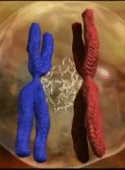
Learning Intentions
Crossing over, non-disjunction and random assortment of chromosomes during meiosis will produce gametes with different genetic content

Slide 4
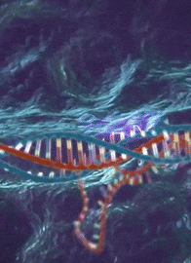
Success criteria
Describe how crossing over creates daughter cells that are all different to each other and the parent cell.
Describe non-disjunction and give examples of chromosomal abnormalities that it may give rise to.
Describe random assortment as a mechanism for genetic diversity in sexual reproduction.
Draw diagrams to represent crossing over, non-disjunction and random assortment.

Slide 5
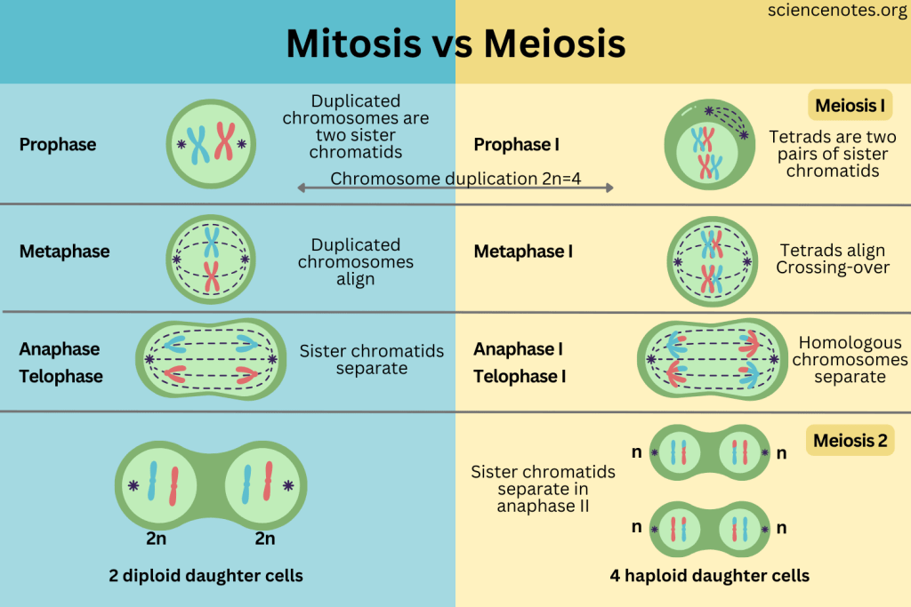

Slide 8
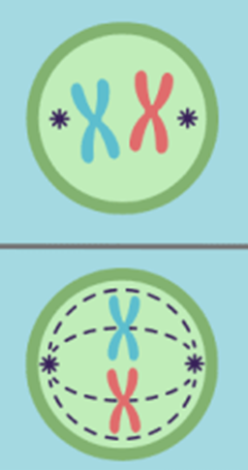

Slide 9
Crossing over
During the first prophase of meiosis, homologous chromosomes are paired. Chromatids may cross, break and exchange segments. This recombination results in unique gene combinations.

Slide 10
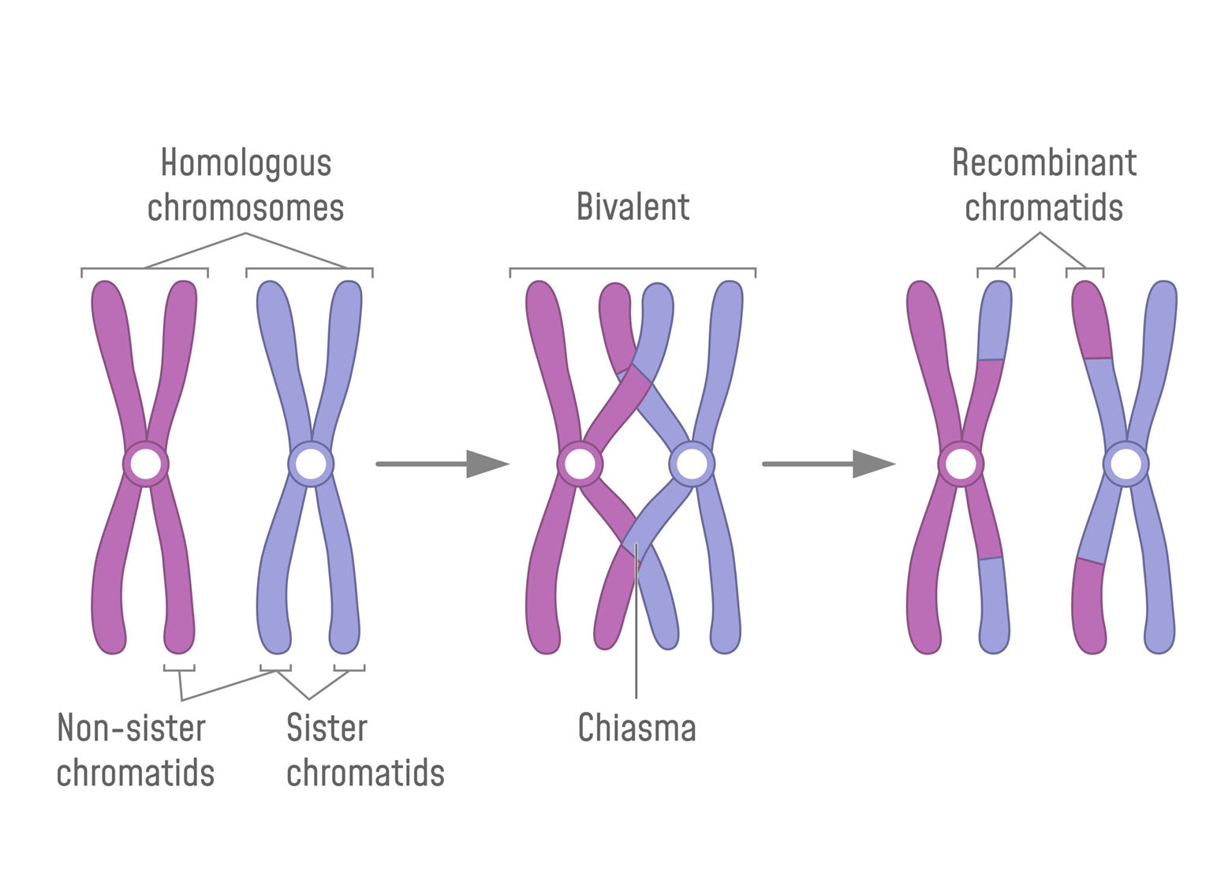

Slide 12

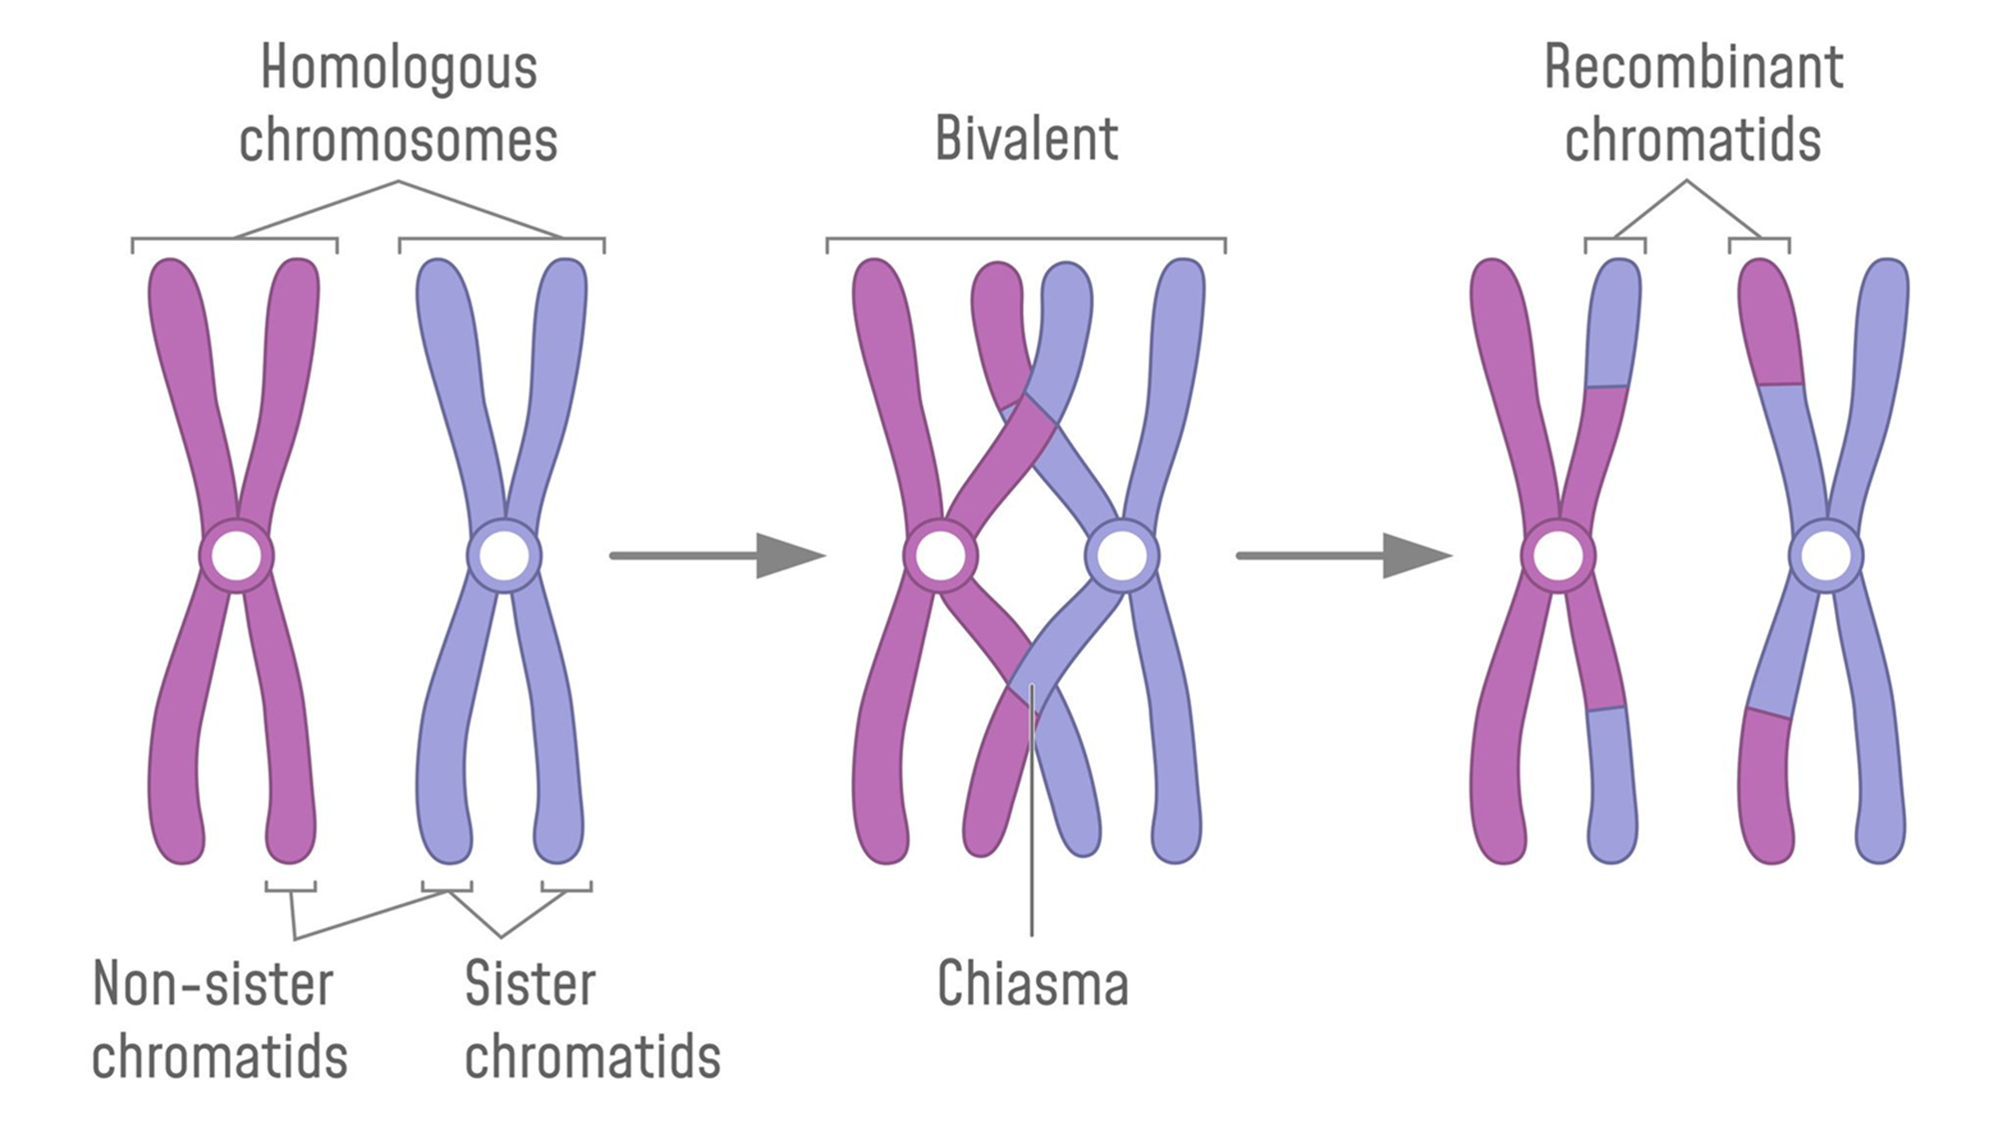
Tetrad

Slide 13
 | pairs of chromosomes containing genes for the same characteristics
 | identical chromatids formed by replication of the chromosome during S phase of the cell cycle
 | chromatids with the same genes but different alleles
 | a pair of homologous chromosomes
 | a set of four chromatids
 | point of contact between chromatids within a homologous pair (site of crossing over)
 | multiple points of contact between chromatids within a homologous pair (pleural of chiasma)
 | chromatids which have exchanged genetic material to form a unique chromatid

Slide 14
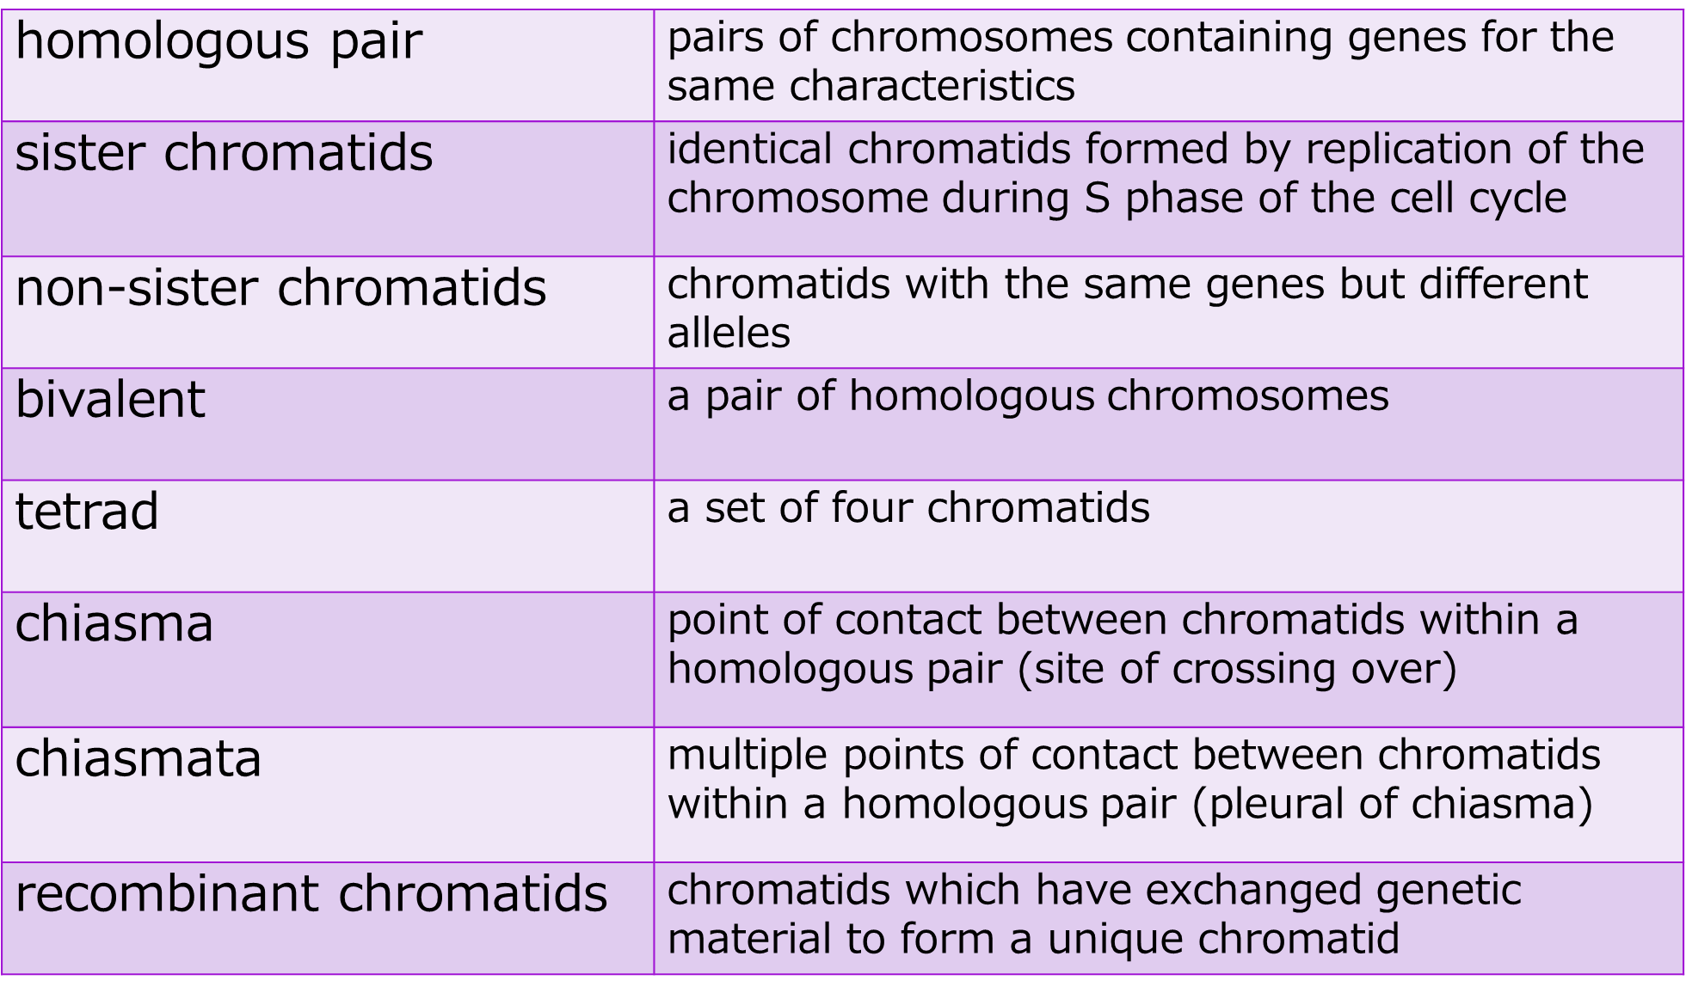

Slide 15
homologous pair | pairs of chromosomes containing genes for the same characteristics
sister chromatids | identical chromatids formed by replication of the chromosome during S phase of the cell cycle
non-sister chromatids | chromatids with the same genes but different alleles
bivalent | a pair of homologous chromosomes
tetrad | a set of four chromatids
chiasma | point of contact between chromatids within a homologous pair (site of crossing over)
chiasmata | multiple points of contact between chromatids within a homologous pair (pleural of chiasma)
recombinant chromatids | chromatids which have exchanged genetic material to form a unique chromatid

Slide 16
Non-disjunction
Failure of the homologous pairs to divide properly in Anaphase I, or of the sister chromatids to divide properly in Anaphase II results in an imbalance in the number of chromosomes in each daughter cell.

Slide 17
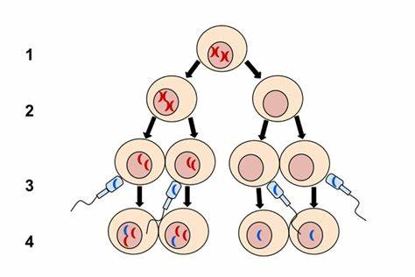
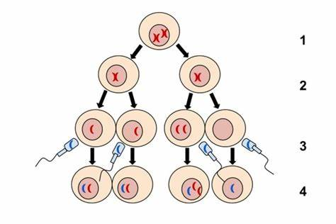

Slide 18
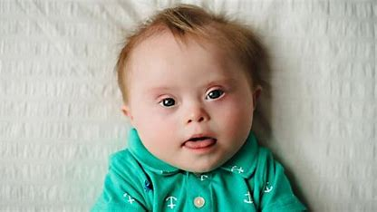
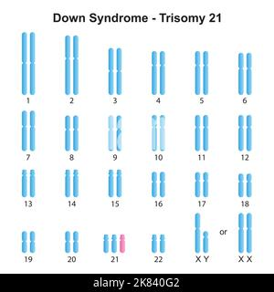
Non-disjunction
This results in chromosomal abnormalities due to too many or too few chromosomes, eg Down’s Syndrome.

Slide 19
Non-disjunction

Slide 20
Occurs more often in cells of older individuals.
Chromosomal abnormalities can also be inherited from parents who carry the abnormalities.
Can also occur in mitosis.

Slide 21
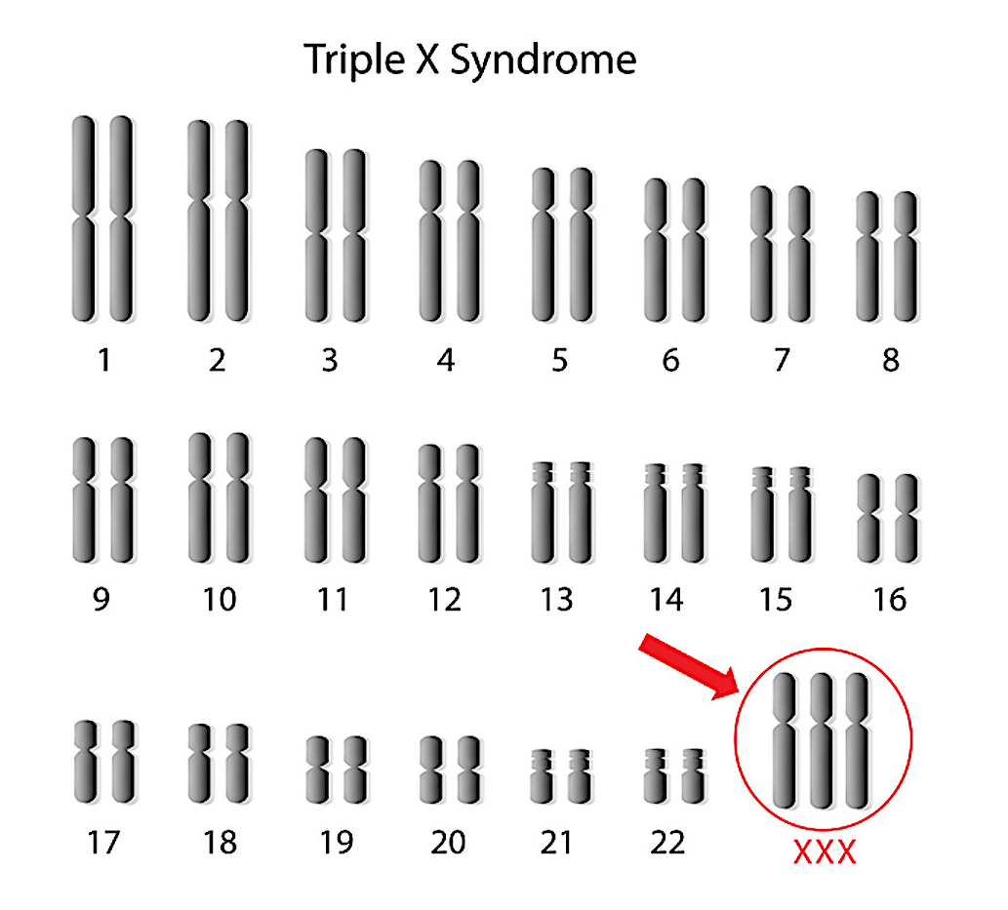
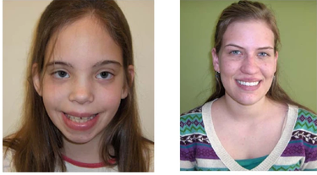

Slide 22
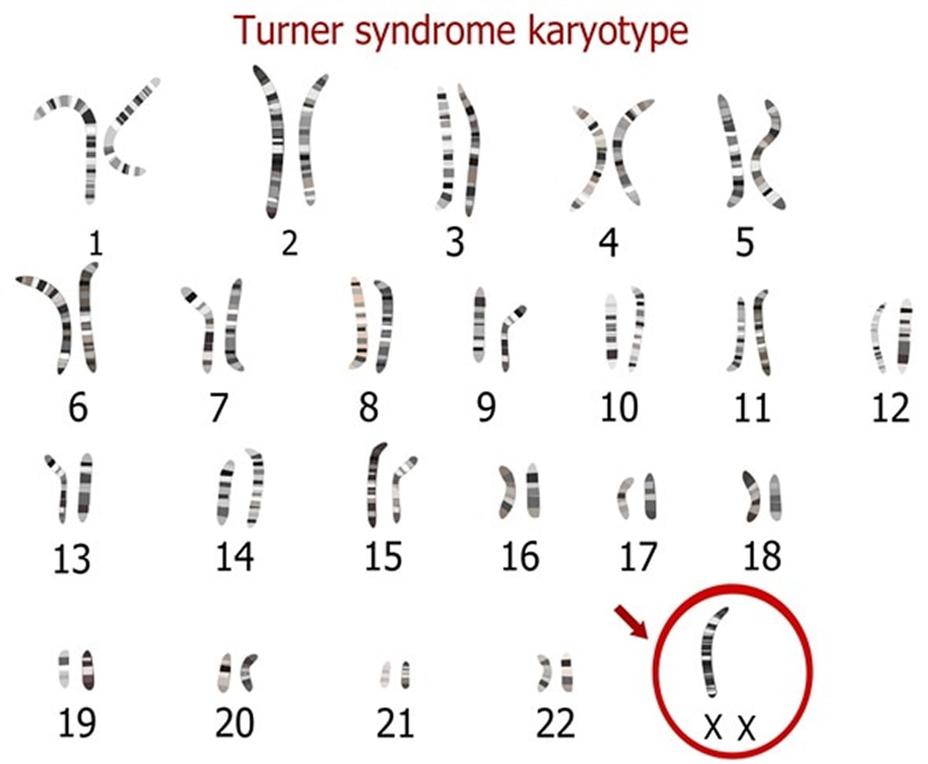


Slide 23
Random Assortment
During Metaphase I, the homologous pairs line up at the equator of the cell.
Which of the pair ends up on which side of the equator is random, resulting in daughter calls that have a unique combination of both parents’ genetic code.

Slide 24
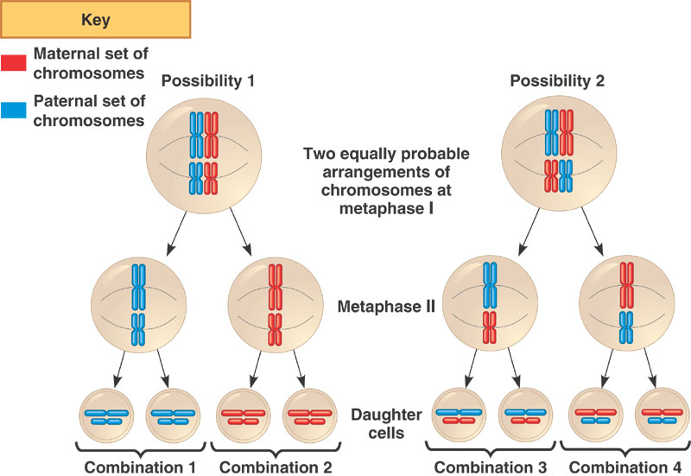

Slide 25
Random assortment
Even before crossing over, with 23 pairs of chromosomes, there are 2²³ possible combinations.
8 388 608

Slide 26
Success criteria
Describe how crossing over creates daughter cells that are all different to each other and the parent cell.
Describe non-disjunction and give examples of chromosomal abnormalities that it may give rise to.
Describe random assortment as a mechanism for genetic diversity in sexual reproduction.
Draw diagrams to represent crossing over, non-disjunction and random assortment.

